Slide 1
Case Study: How does Bike-Share Navigate Speedy Success?
Case Background
➤ Cyclistic is the Bike-Sharing company located in chicago.
➤ The clients are categorized into two types Annual Members and Casual Members. The future success of the company depends upon maximizing the number of Annual Membership.

Slide 2
Business Task:
➤ Finding the insights so that it will help design a new marketing strategy to convert casual riders into annual members.
➤ Analyze how Annual Riders and Casual Riders differ in behaviour.

Slide 3
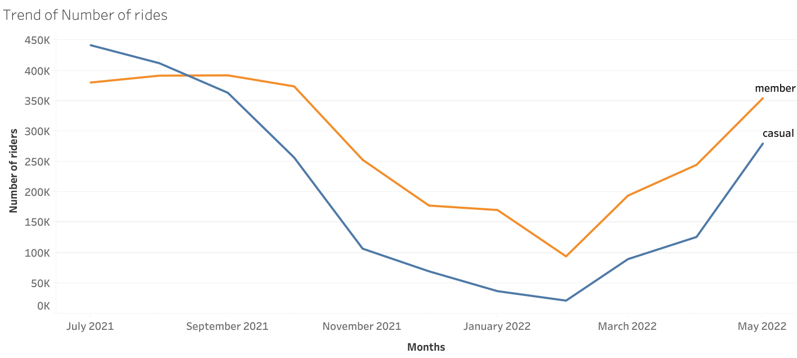
Seasonal Trend

Slide 4
Seasonal Trend takeaways
➤ From the month of september till almost march the trend of rides is steadily going down.
➤Both the Casual riders and Annual Member rider’s trend is highest in july month.
➤ From month of April the number of rides for both the members are increasing steadily.

Slide 5
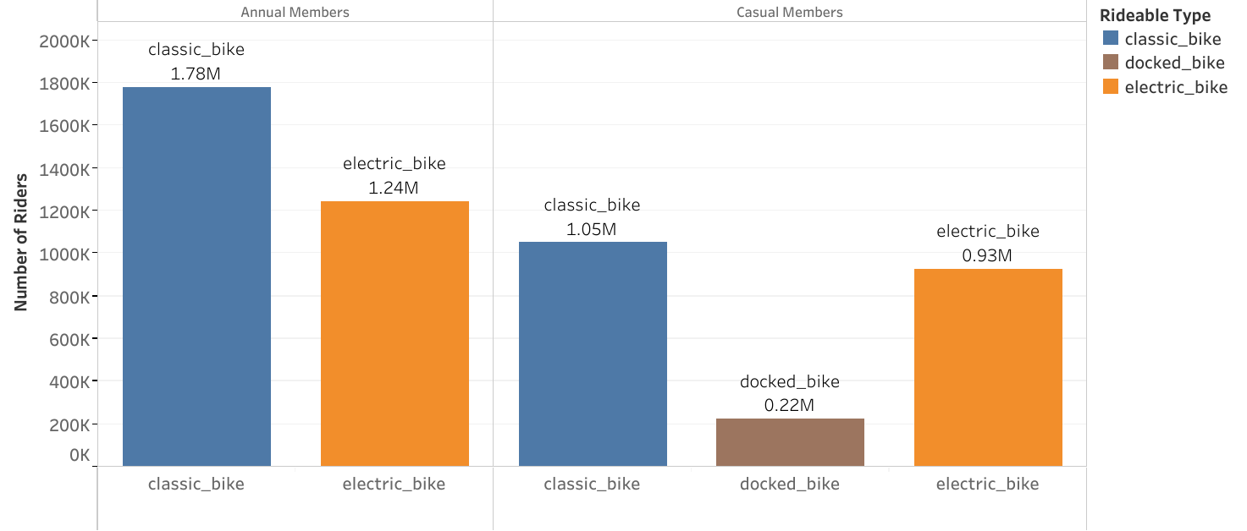
Ride preferences

Slide 6
Ride preferences takeaways
➤ Classic bike has highest demand coming from both the members.
➤ Casual member prefer docked bikes too but Annual member preferences is more inclined only towards classic bike and electric bikes.

Slide 7
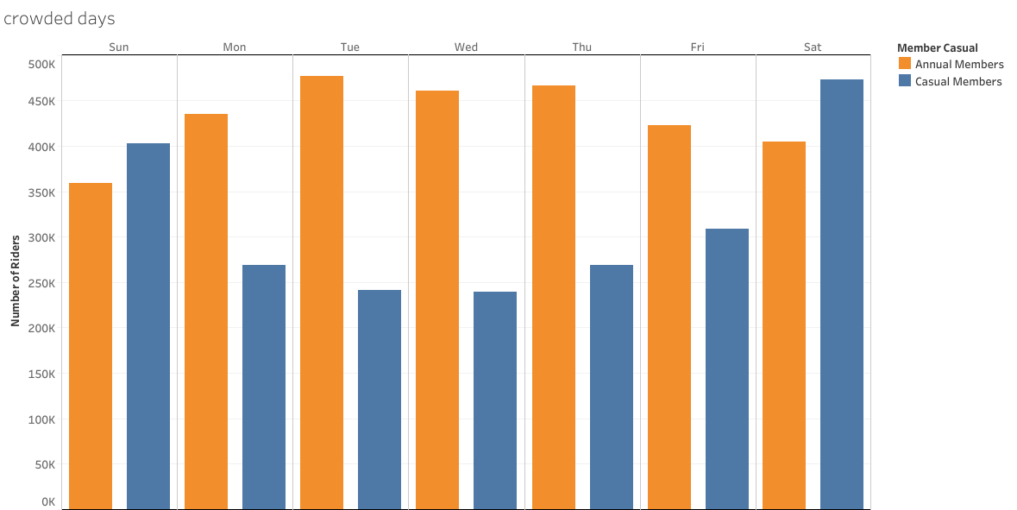
Crowded days

Slide 8
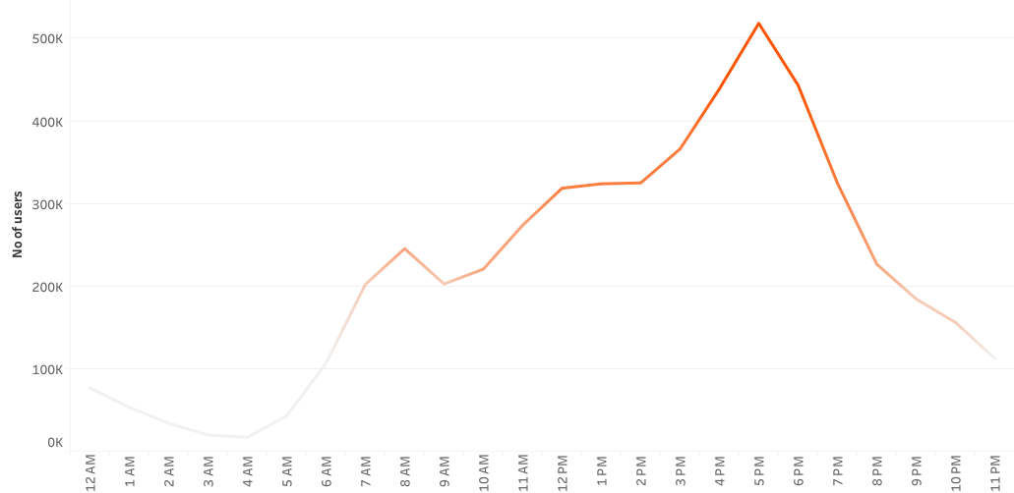
Crowded hours

Slide 9
Crowded Days and hours takeaways
➤ As we can see that Casual members prefers rides more on weekends rather than weekdays whereas Annual Member prefers rides on weekdays.
➤Highest number of riders recorded in between range of 2pm to 7pm where peak time between 4pm to 6pm.

Slide 10
Recommendations :
➤ As during April to july months there is demand from casual riders too it would get easier to convert them for Annual membership.
➤As Casual riders prefers rides more on weekends we can run marketing campaign on weekend between 4pm to 7pm so it would be easier to target and capture our ideal audience.
➤We should focus on increasing the classic bikes and then electric bikes available for ride as there is huge demands for these two bikes more than docked type bike.

Slide 11
Thank You

